Slide 1
Data Analytics Project
Group Members
Muhammad Hammd Arshad
Owais Safdar
Hafiz Samran Elahi
Topic Bird Dataset Analysis

Slide 2
Data Analytics Project
Introduction: We choosed Birddataset. Bird diversity plays a crucial role in maintaining healthy ecosystems. This study examines 95 bird species in a specific region of Australia, exploring their flight behaviours and habitat preferences
Problem Statement: Understanding the factors that influence flight patterns and habitat choices is vital for bird conservation. Traditional observation methods can be costly and time-consuming, making efficient predictive modeling essential for effective ecological management.

Slide 3
Research Question
How can we predict bird species using flight height and habitat? Three variables include Height_max , HABITAT and SPECIES.
Is there a significant link between maximum flight height, species, and habitat? Three variables include Height_max , HABITAT and SPECIES.
Does the inclusion of geographic coordinates improve the accuracy of species predictions? Five variables include SPECIES, Height_max, SITE_ID, Latitude and Longitude

Slide 4

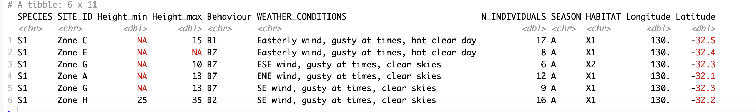
Dataset Overview
Total Variables= 11, Rows: 2090
Data types= char/categorical , dbl/Continue Numeric
SPECIES= 95
SITE_ID= 8 A – H
HABITAT= 8 X1 – X2

Slide 5
Data Cleaning and Preprocessing
Handling Missing Values: Checked for any missing data in key variables like Height_max, Height_min, Latitude, and Longitude.
Imputed or excluded missing values based on their relevance and distribution.
Outlier Detection: Identified outliers in Height_max that heavily skewed the data.
Used boxplot and histogram to visualize these outliers, mainly in the upper range.
Outlier Removal:Removed extreme values in Height_max to achieve a more balanced distribution.
This step reduced the impact of outliers on statistical analyses, allowing for a clearer data pattern.

Slide 6
Data Analysis and Transformation
Perform Four Steps to Analyze the Data
Composition
Distribution
Comparison
Correlation

Slide 7
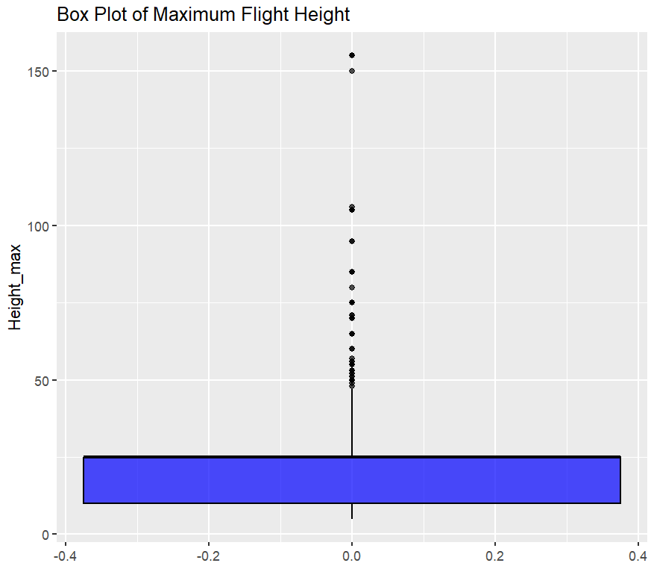
Data Analysis and Transformation
Histogram: Most Height_max values are low, with a spike near zero; few high values create a long right tail.
Boxplot: Shows lower-range clustering with many high outliers, reinforcing the skewed distribution.
Density Plot: Strong peak at low heights, with a long tail suggesting some birds fly much higher.
QQ Plot: Deviation from the normal line in upper quantiles indicates non-normality due to outliers.

Slide 8
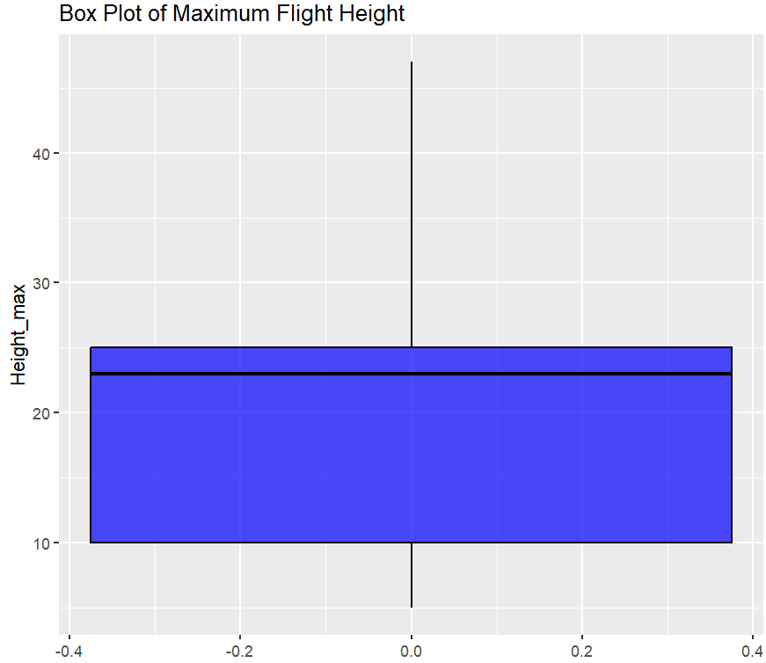
Data Analysis Post Transformation
Histogram: Most Height_max values are low, with a spike near zero; few high values create a long right tail.
Boxplot: Shows lower-range clustering with many high outliers, reinforcing the skewed distribution.
Density Plot: Strong peak at low heights, with a long tail suggesting some birds fly much higher.
QQ Plot: Deviation from the normal line in upper quantiles indicates non-normality due to outliers.

Slide 9
Discussion Problem A
Predict bird species using flight height and habitat type?
Model : Decision Tree Model
Reason: Response variable categorical
Response Variable: Species, Exploratoty Variable: Height_Max and HABITAT
Data Preprocessing: Remove Rows with NA and Reord not found, Use thouse entries who have more than 30 meter Height_Max, Do factorization.

Slide 10
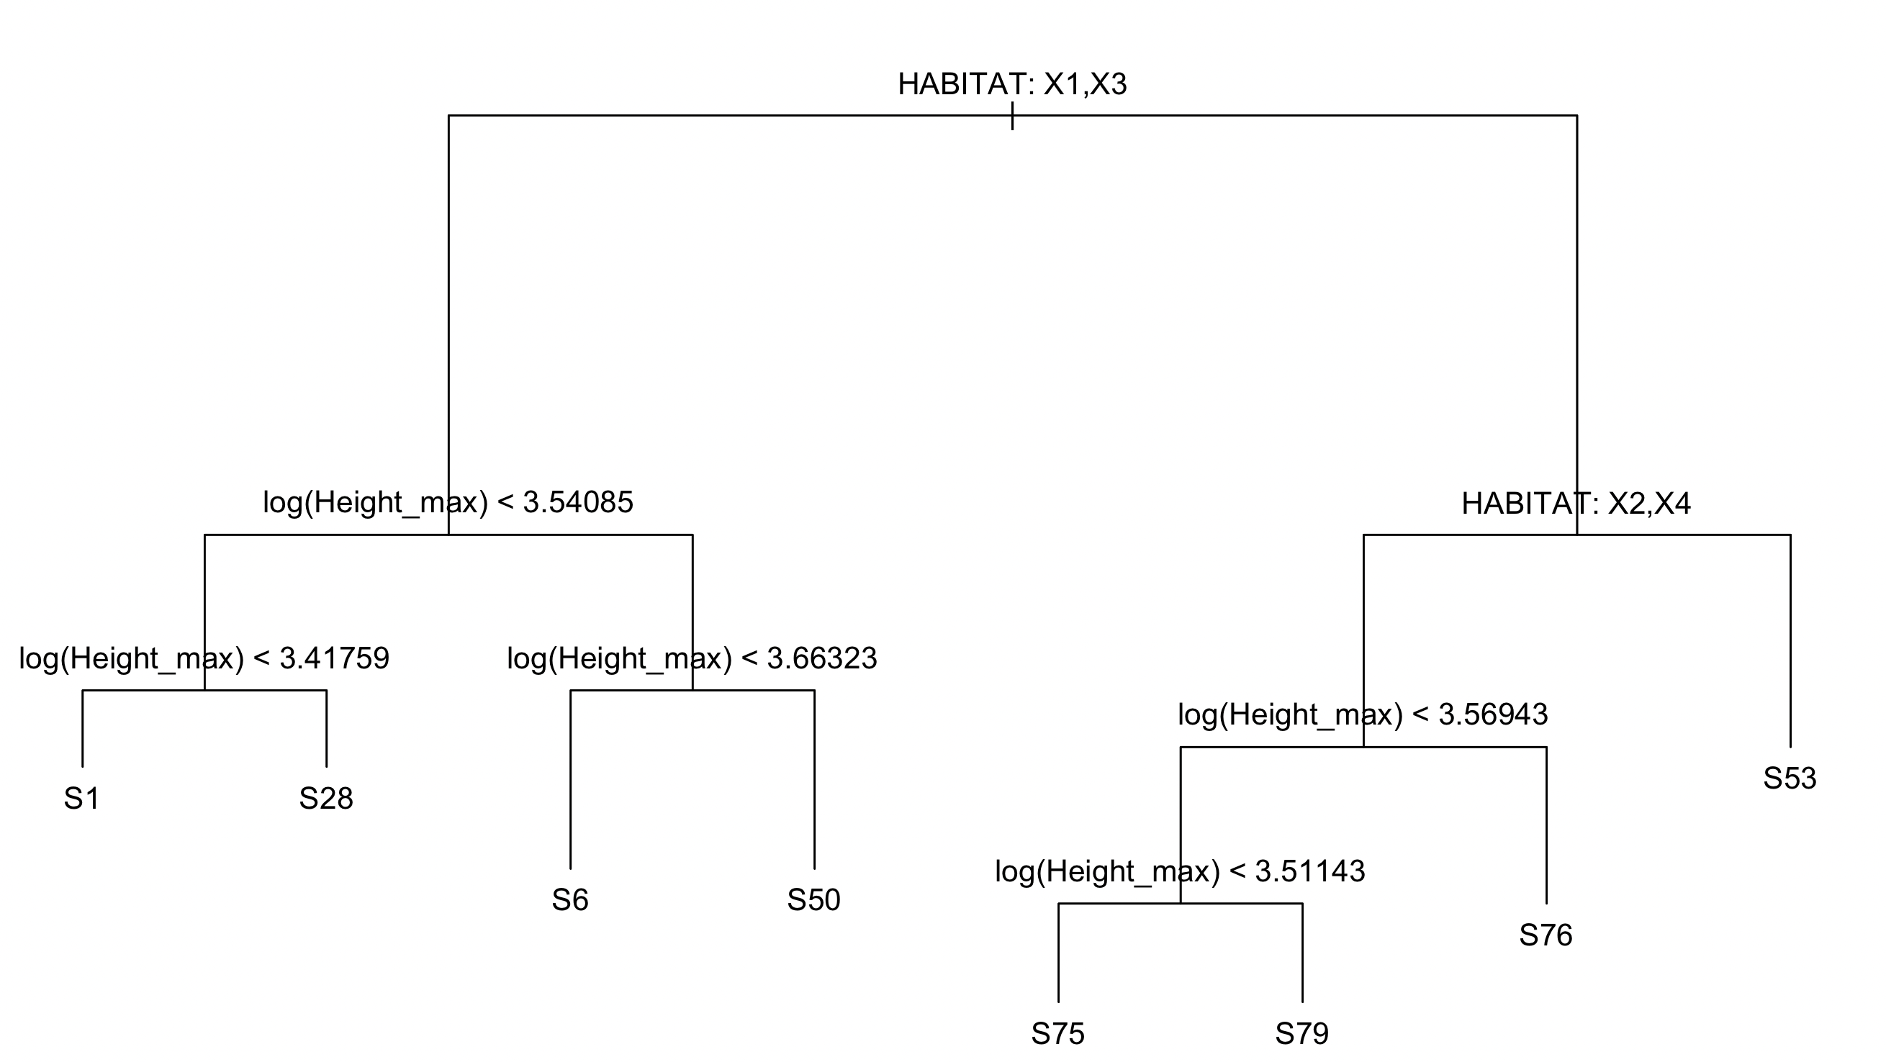
Discussion Problem A
Results

Slide 11
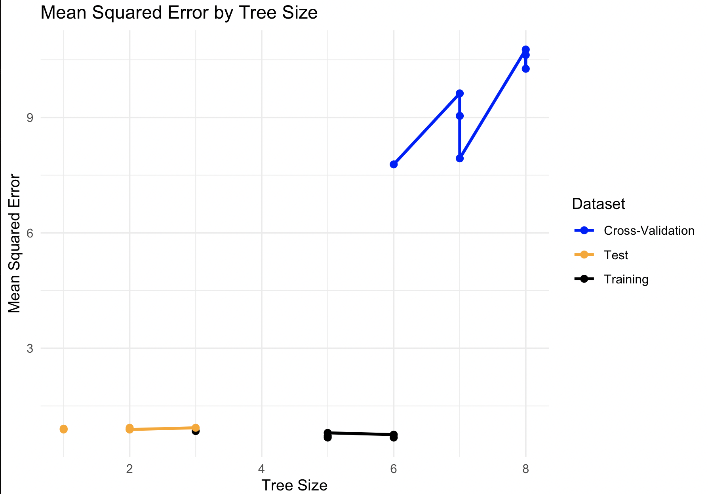
Discussion Problem A
Find Best Number of Terminal Node
We use K fold cross validation

Slide 12
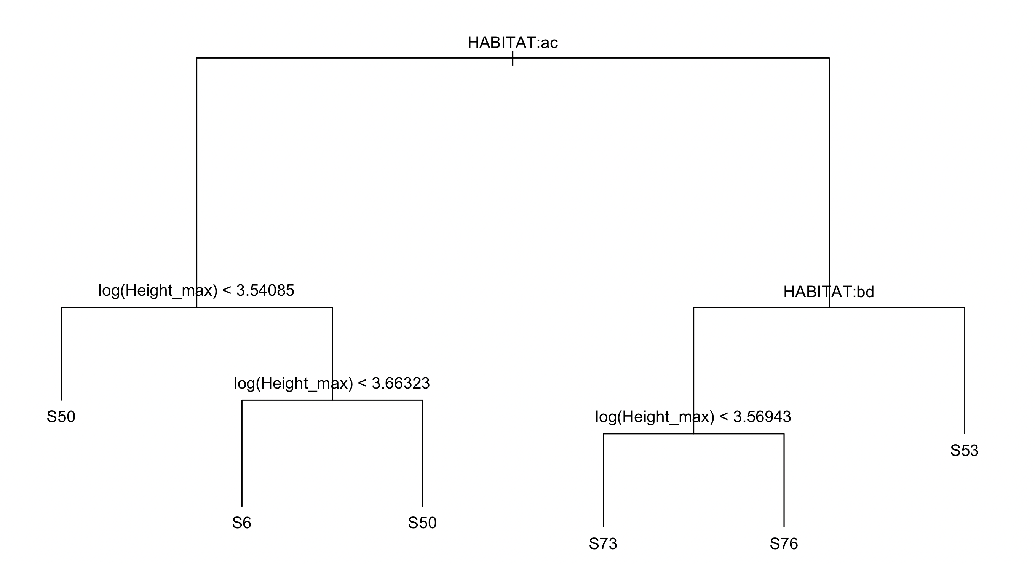
Discussion Problem A
Pruned Tree

Slide 13
Discussion Problem B
Is there a link between maximum flight height, species, and habitat?
Model : Multiple Linear Regression (MLR)
Reason: Height_max is our response variabe and it’s continues
Response Variable: Height_max , Exploratoty Variable: SPECIES and HABITAT
Data Preprocessing: Remove Rows with NA and Reord not found, factorization categorical variables.

Slide 14
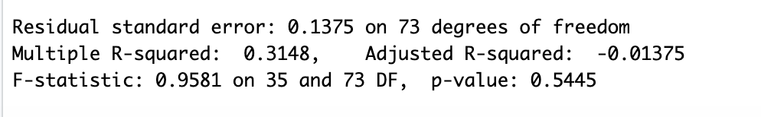
Discussion Problem B
After Apply Model We found there is no strong relationship between response variabel (Height_max) and exploratory variabeles (HABITAT and SPECIES)

Slide 15
Discussion Problem B
Hypothesis Test
Null Hypothesis (H₀): There is no significant relationship between maximum flight height and the variables Species and Habitat.
Alternative Hypothesis (H₁): There is a significant relationship between maximum flight height and the variables Species and Habitat. A high p-value (p > 0.05) led us to fail to reject the null hypothesis.

Slide 16
Discussion Problem C
Does adding geographic coordinates to flight height and site ID improve species prediction?
Model Selection: We Selected Linear Discriminant Analysis (LDA)
Reason: LDA works well with categorical response variables and a mix of numerical and categorical predictors.
Response Variable: SPECIES, PERDICTORS: Height_max, SITE_IT, Latitude and Longitude
We prepared two model one without geographic(Latitude and Longitude) and one with geographic variables.

Slide 17
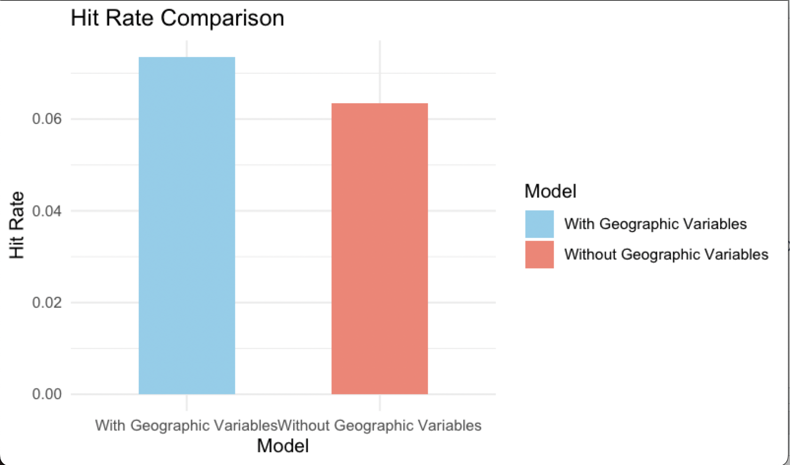
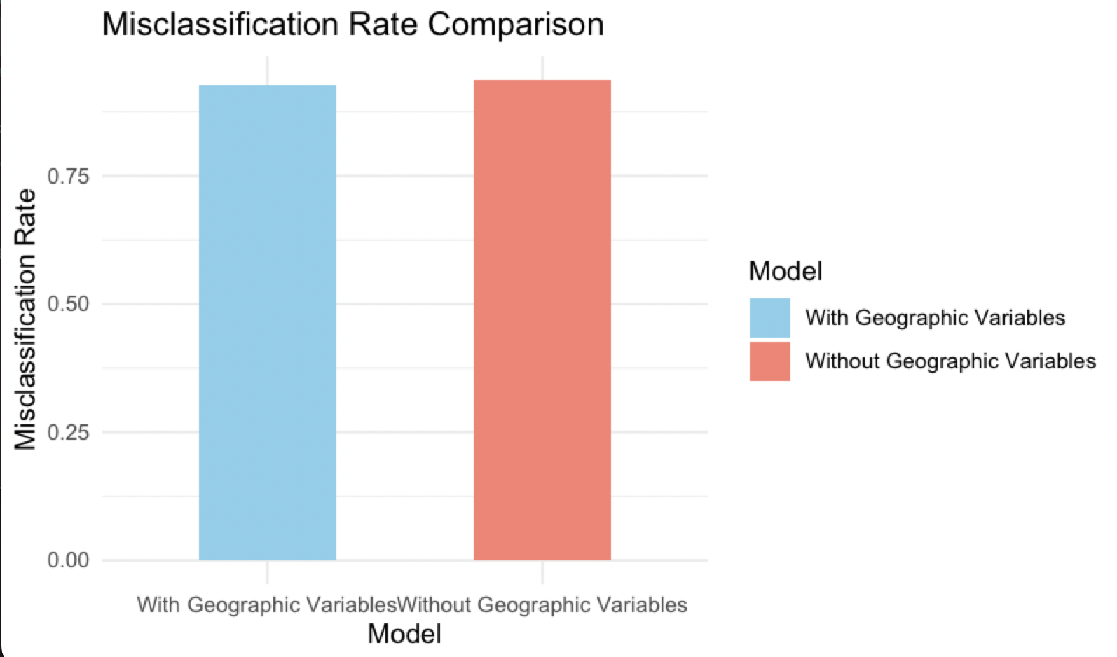
Discussion Problem C
Model without Geographic:
Hit Rate (Accuracy): 6.89% (0.0689)
Misclassification Rate: 93.11% (0.9311)
Model with Geographic :
Hit Rate (Accuracy): 7.30% (0.0730)
Misclassification Rate: 92.70% (0.9270)
Yes, Geographic coordinates slightly improve the the ability to perdict.

